Slide 1


Resume Classification
Group Members -
Ishmeet Singh
Suhas Reddy
Swagatika Sahoo
Anusha.N
Shruti Lahu Lanke
Chandan Gowda T K
Sakshi Patil

Slide 2


Problem Statement
The recruitment process requires HR departments to manually sort and categorize a large volume of resumes.
Manual sorting is time-consuming and resource-intensive, making it inefficient.
Human errors during manual classification can lead to:
Misclassification of resumes.
Missed opportunities to identify suitable candidates.
Delays in manual processing negatively affect the hiring pipeline, increasing the risk of losing top talent.
Inconsistencies arise due to varying human interpretation, complicating decision-making.
An automated solution is essential to:
Streamline resume classification.
Reduce errors and delays.
Enhance hiring efficiency and consistency.
2

Slide 3


Objective
Develop an automated document classification solution tailored for HR management (HRM).
Significantly reduce the manual effort involved in sorting and categorizing resumes.
Achieve high levels of accuracy in resume classification, ensuring reliable results.
Implement automation to streamline the process, minimizing the need for human intervention.
3

Slide 4
Project Architecture
Collection of Data
Business Understanding
Exploratory Data Analysis(EDA)
Deployment
Model Building
3

Slide 5
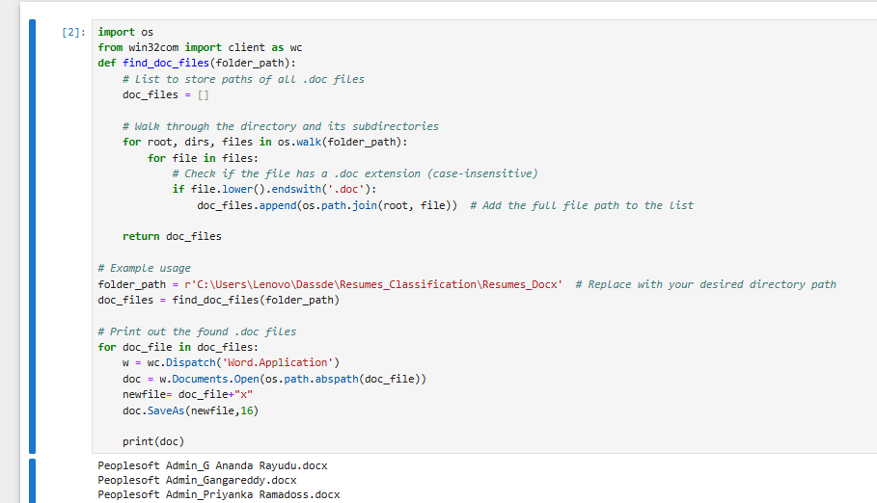
Collection of Data
01.Convert the Doc files to Docx then extract the text via Textract and Py PDF
Resumes in document [DOC, DOCX, TXT, PDF] format were systematically converted into a single consolidated CSV dataset for uniformity.
Once data is converted to CSV via Textract and PyPDF then its shared for Understanding the Business logic for the data via EDA process
4

Slide 6
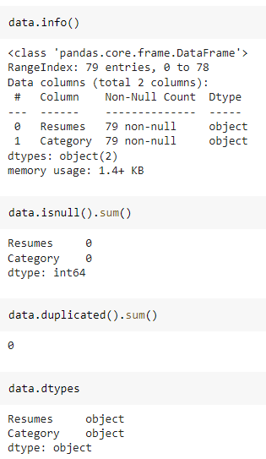
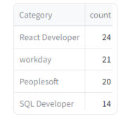
Implementation
02. Preprocessing for the data
Performed extensive Exploratory Data Analysis (EDA) to clean and preprocess the data, ensuring it was standardized and ready for model fitting.
After Extracting and Modifying the Dataset, given data contains a total of 4 Classes and 79 rows .
4

Slide 7
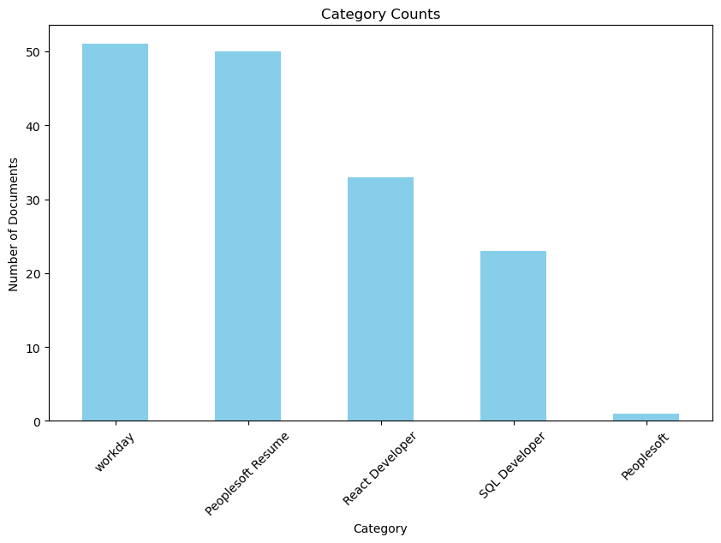
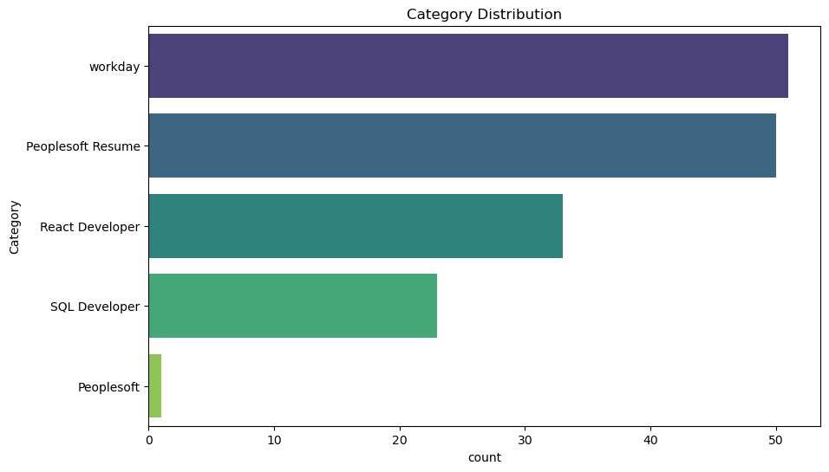
Insights from Exploratory Data Analysis (EDA)
Category Count: A bar chart showing the total number of resumes in each category, highlighting the dataset's balance or imbalance across classifications.
Category Distribution: A bar chart visualizing the proportional representation of each category in the dataset.
5

Slide 8
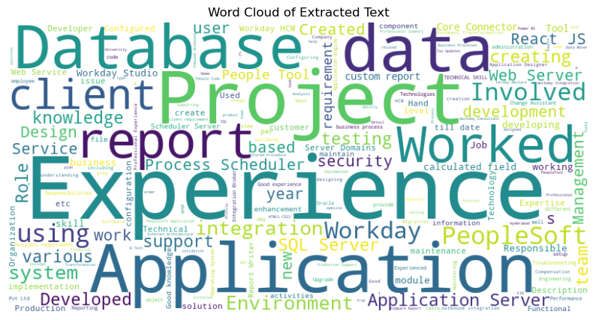
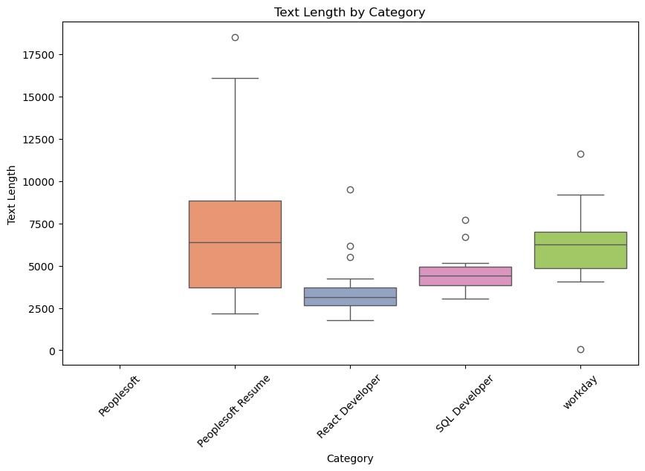
Word Cloud: A visually engaging representation of the most frequent words across all resumes, providing insights into common themes and keywords.
Text Length by Category: A boxplot showing the variation in resume text length across different categories, indicating content differences by classification.
6

Slide 9
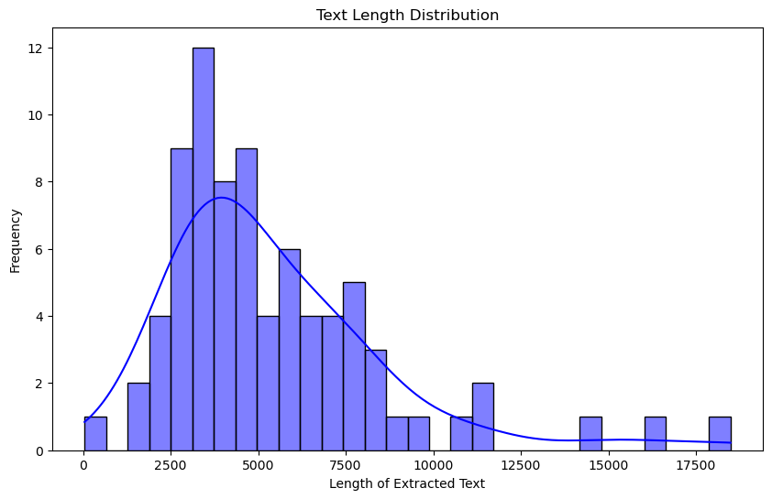
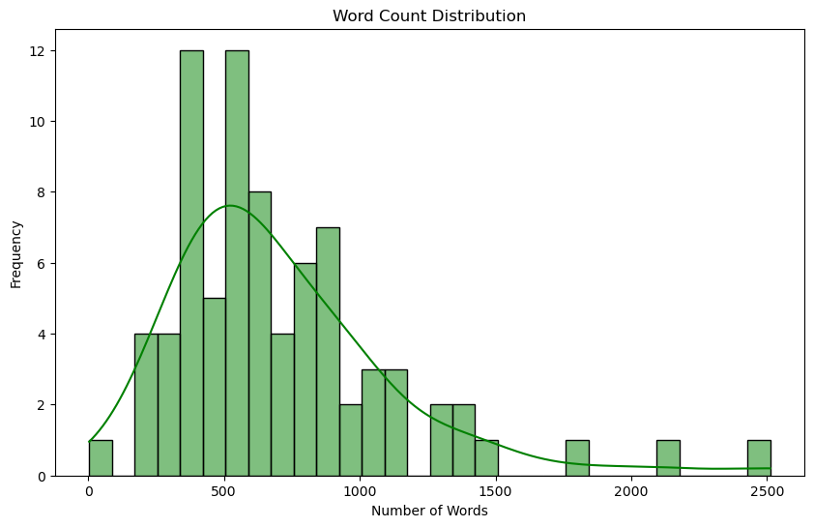
Text Length Distribution: A histogram showcasing the overall distribution of text lengths in the dataset, revealing patterns or outliers in resume content.
Word Count Distribution: A histogram depicting the distribution of word counts across resumes, highlighting content variability in the dataset.
7

Slide 10
02. Model Selection
Naive Bayes: This probabilistic model is simple and efficient, leveraging Bayes' theorem to classify resumes based on word occurrences. Its assumption of feature independence makes it suitable for text data but may oversimplify complex patterns.
Random Forest: An ensemble learning method that combines multiple decision trees to improve classification accuracy. It excels at handling imbalanced datasets and capturing non-linear relationships in the resume features.
Decision Tree: A tree-structured algorithm that splits data based on feature thresholds to classify resumes. While interpretable and fast, it can be prone to overfitting without pruning techniques.
Logistic Regression: A statistical method for binary classification that models the relationship between input features and class probabilities. It works well for linearly separable data and provides interpretable coefficients.
XGBoost: A gradient-boosting algorithm that builds decision trees sequentially to optimize classification performance. Known for its speed and scalability, it often outperforms other models in structured datasets.
8

Slide 11
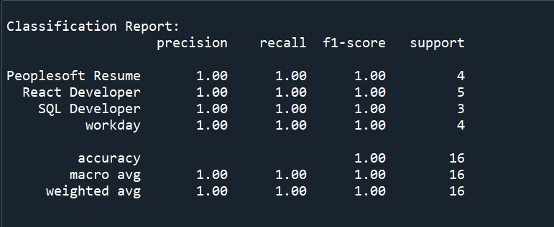
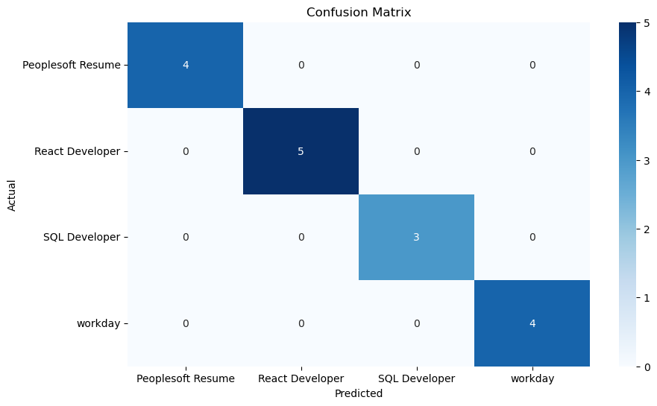
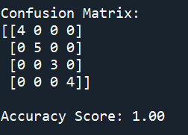
03. Model Evaluation Report
After evaluating all models based on performance metrics, Naive Bayes was selected for deployment.
Key reasons for selection:
Simplicity: Easy to implement and computationally efficient.
High Accuracy: Achieved a 97% accuracy in classifying resumes.
Efficiency: Performs well with text data and handles feature independence effectively.
9

Slide 12
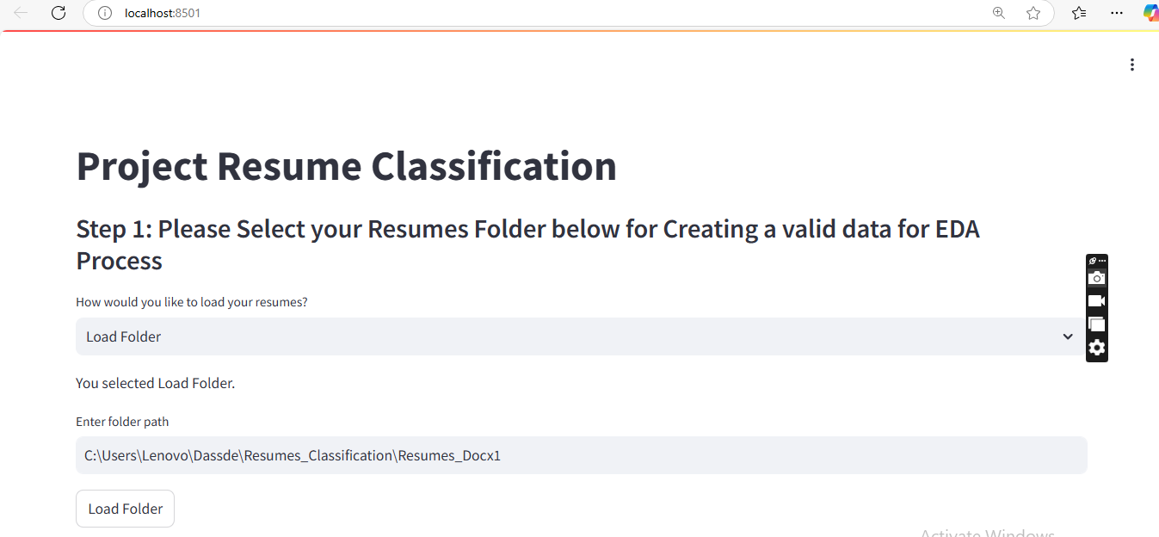
04. Model Deployment
Here, we have taken Naïve Bayes Model as our Final Model algorithms for the deployment.
The algorithm has achieved 97% Accuracy, Precision, Recall and F1-score on testing data.
97% accuracy is achieved by using the model Random Forest no misclassification on validation set.
We have deployed the Resume Classification using Stream-lit as the platform
Here an HR will select Load folder and Enter the Folder path where the Resumes are residing
10

Slide 13
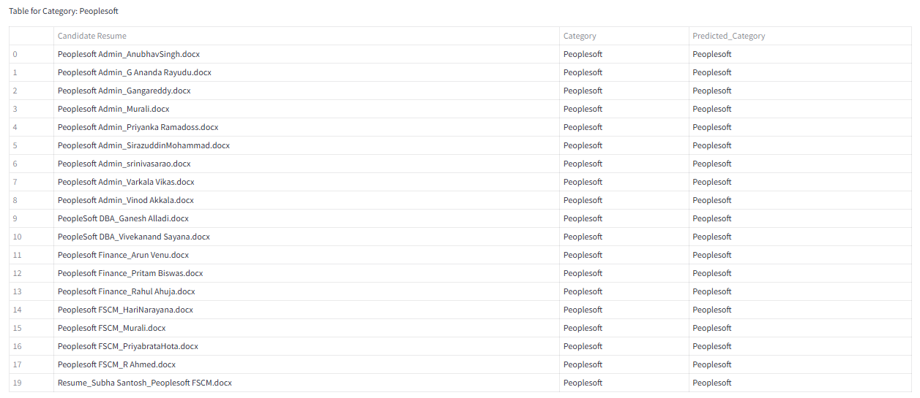
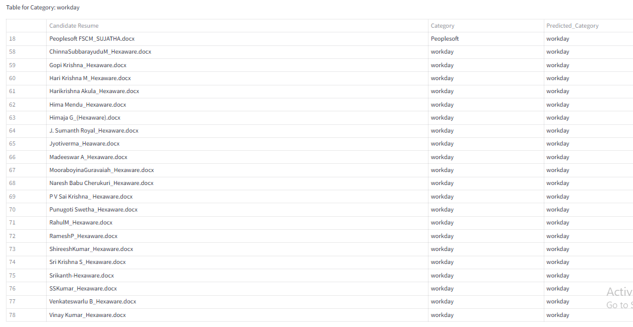
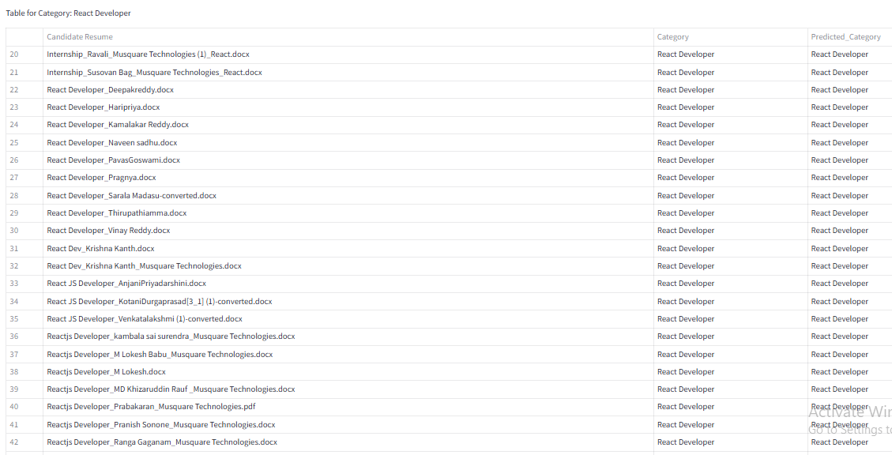
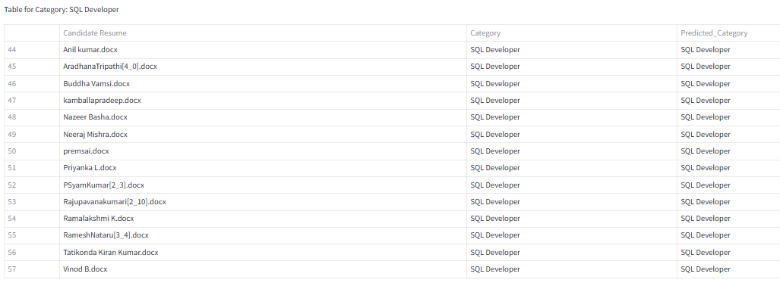
05. Model Predicted Categories
11

Slide 14
Problems Faced & Solutions
Problem 1: Handling Diverse Resume Formats Resumes came in various formats, including PDFs and Word documents making it challenging to process them uniformly. This diversity created inconsistencies during data extraction and conversion. Solution: To address this, we standardized all resumes into a unified format before converting them into a structured dataset. This preprocessing step ensured consistency and improved the quality of input data for the classification models.
Problem 2: Choosing the Best-Performing Model With several machine learning models available, selecting the most effective one for resume classification was a challenge. Each model had its strengths and weaknesses depending on the dataset characteristics and evaluation metrics. Solution: We conducted extensive model comparisons by testing various algorithms, including Naive Bayes, Random Forest, Logistic Regression, and XGBoost. Although Random Forest initially emerged as a strong contender, Naive Bayes was eventually deployed due to its simplicity, efficiency, and ability to achieve 97% accuracy.
12

Slide 15

Thank you

